Slide 1

DIABETES PREDICTION SYSTEM

Slide 2
Introduction
The Diabetes Prediction System is a Python Django web application that uses Support Vector Machine (SVM) for predicting the likelihood of diabetes based on various parameters. It includes user and admin modules, allowing users to make predictions, view prediction history, and manage their profile, while admins have access to user and prediction data. The system aims to provide accurate predictions, assist individuals in assessing their risk for diabetes, and offers a user-friendly interface for easy management.

Slide 3
Problem Definition
The Diabetes Prediction System using Support Vector Machine addresses the challenge of accurately predicting diabetes in individuals by analyzing relevant parameters. It aims to aid in early detection and timely intervention, assisting healthcare professionals and individuals in making informed decisions about preventive measures and treatment options.

Slide 4
Objective
The objectives of the Diabetes Prediction System using Support Vector Machine are to develop an accurate prediction model, improve prediction accuracy, provide a user-friendly interface, ensure secure data management, offer user and admin module functionalities, evaluate and optimize system performance, ensure scalability and extensibility, integrate and deploy the system, and provide documentation and support. By achieving these objectives, the system aims to contribute to early detection and effective management of diabetes, ultimately improving healthcare outcomes for individuals at risk.

Slide 5
Need of The System
The Diabetes Prediction System using Support Vector Machine addresses the need for early detection and prevention of diabetes by providing accurate risk assessments based on individual parameters. It offers efficient screening, personalized care, data-driven insights, and a user-friendly interface. By fulfilling these needs, the system contributes to proactive health management and improved health outcomes for individuals at risk of diabetes.

Slide 6
Purpose
The Diabetes Prediction System using Support Vector Machine serves the purpose of early detection and prevention of diabetes by utilizing machine learning algorithms. It provides risk assessments, supports decision-making for healthcare professionals, empowers individuals, and contributes to research and public health strategies. The system aims to facilitate proactive health management and improve outcomes related to diabetes.

Slide 7
Project Scope
The scope of the Diabetes Prediction System using Support Vector Machine is significant in the healthcare industry. The system can be adopted by hospitals, clinics, and healthcare providers to assist in diabetes risk assessment and preventive care. Additionally, pharmaceutical companies and research institutions can leverage the system for data analysis and research on diabetes risk factors. The system's application extends to public health organizations and policymakers for developing targeted interventions and strategies to combat the increasing prevalence of diabetes. Overall, the system has a broad market scope and can make a substantial impact in the healthcare and diabetes management sectors.

Slide 8
Proposed System
The proposed system for the Diabetes Prediction System using Support Vector Machine is a machine learning-based web application developed using Python Django framework with a SQLite database. The system aims to predict the likelihood of an individual developing diabetes based on various parameters such as pregnancies, glucose levels, skin thickness, insulin levels, BMI, diabetes pedigree function, and age. Users can register, log in, make predictions, view their prediction history, and update their profile. The system provides a user-friendly interface for diabetes risk assessment, empowering individuals to take proactive measures for disease prevention and management.

Slide 9
User Modules:
Signup: Users can create an account by providing their details and registering in the system.
Login: Users can log in to the system using their credentials.
Prediction: Users can input their health parameters, such as Pregnancies, Glucose level, Skin Thickness, Insulin level, BMI, Diabetes Pedigree Function, and Age, to obtain a prediction of their likelihood of having diabetes.
View Prediction History: Users can view their prediction history, which provides a record of their previous predictions and their corresponding results.
Edit Profile: Users have the ability to update and modify their profile information, such as their personal details and contact information.
Change Password: Users can change their password for enhanced security.
Logout: Users can log out of the system to end their session securely.

Slide 10
Admin Modules:
Login: The admin can log in to the system using their credentials.
Dashboard: The admin can access a dashboard that provides an overview of the system, including user counts and prediction results count.
View Prediction History: The admin can view the prediction history of all users, allowing them to track and analyze predictions made by users.
View Registered Users: The admin can view a list of registered users in the system, providing insights into the user base.
Change Password: The admin has the ability to change their password for security purposes.
Logout: The admin can log out of the system to end their session securely.

Slide 11
SOFTWARE USED
PYTHON INTERPRETER
PYCHARM IDE (INTEGRATED DEVELOPMENT ENVIRONMENT)
DJANGO FRAMEWORK
NOTEPAD++ OR ANY OTHER TEXT EDITOR
CHROME OR ANY OTHER BROWSER

Slide 12
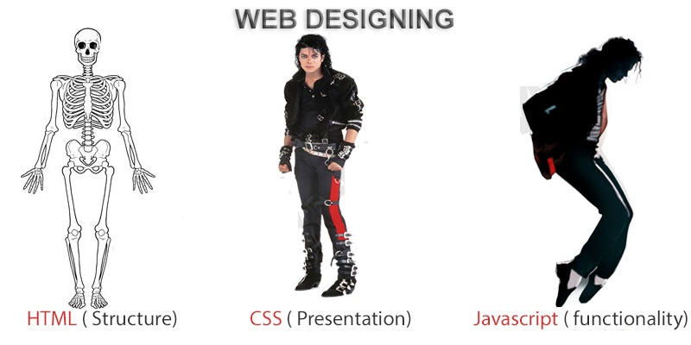
FRONTEND (LANGUAGE USED)
HTML (HYPERTEXT MARKUP LANGUAGE)
CSS (CASCADING STYLE SHEET)
BOOTSTRAP (FRAMEWORK OF HTML,CSS AND JS)

Slide 13
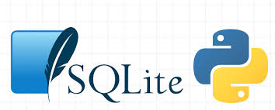
BACKEND
PYTHON DJANGO
SQLITE (DATABASE)

Slide 14
SYSTEM DESIGN
Unified Modeling Language:
UML stands for Unified Modeling Language. It is a third generation method for specifying, visualizing and documenting the artifacts of an object oriented system under development. Object modeling is the process by which the logical objects in the real world (problem space) are represented (mapped) by the actual objects in the program (logical or a mini world). This visual representation of the objects, their relationships and their structures is for the ease of understanding. This is a step while developing any product after analysis.

Slide 15
The Unified Modeling Language encompasses a number of models.
Use case diagrams
Class diagrams
Sequence diagrams

Slide 16
Use Case Diagram:
Use case diagram consists of use cases and actors and shows the interaction between them. The key points are:
The main purpose is to show the interaction between the use cases and the actor.
To represent the system requirement from user’s perspective.
The use cases are the functions that are to be performed in the module.
An actor could be the end-user of the system or an external system.

Slide 17
Use Case Diagrams – Admin :
Admin Dashboard
View Prediction Results History
Manage Reg. Users
(View / Delete)
Change Password
Admin
Logout

Slide 18
Use Case Diagrams User:
Prediction
View prediction Results History
Edit Profile
(Update)
Change Password
User
Logout

Slide 19
Sequence Diagram:
The purpose of sequence diagram is to show the flow of functionality through a use case. In other words, we call it a mapping process in terms of data transfers from the actor through the corresponding objects.

Slide 20
SEQUENCE DIAGRAM

Slide 21
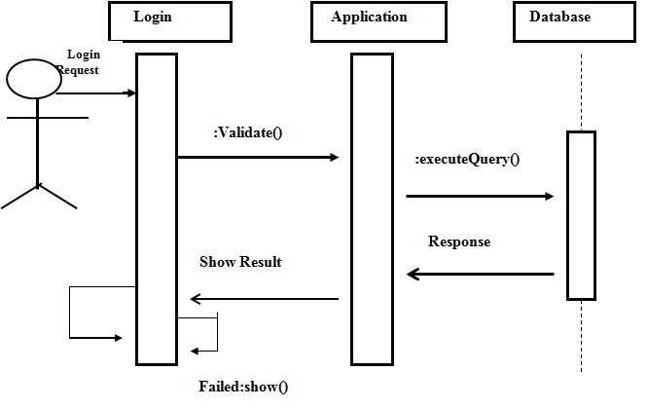
Sequence Diagram For Administrator:-

Slide 22
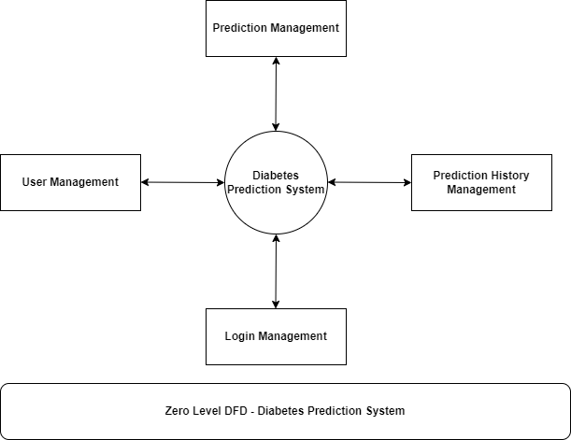
Data Flow Diagram(DFD)

Slide 23
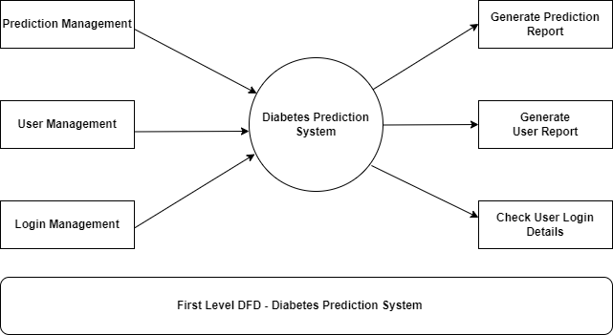
Data Flow Diagram(DFD)

Slide 24
ER Diagram

Slide 25
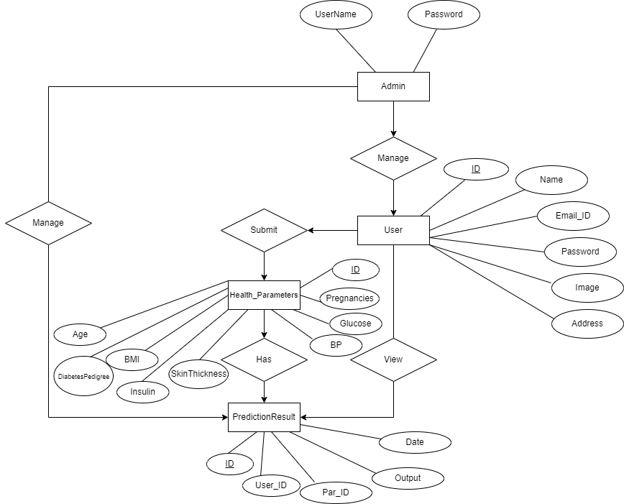

Slide 26
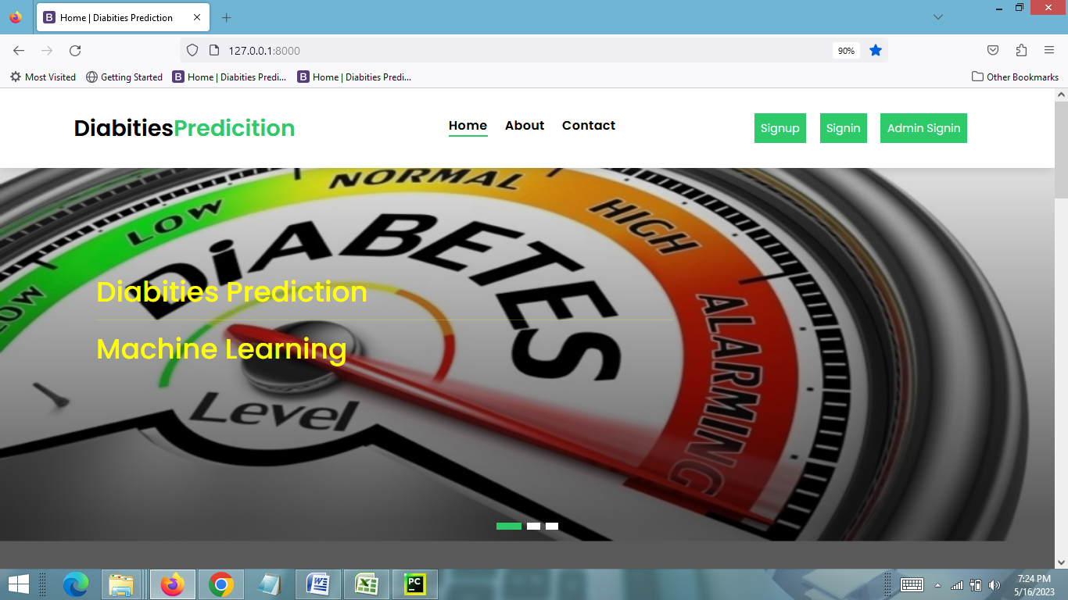
SCREEN SHOTS – Home Page

Slide 27
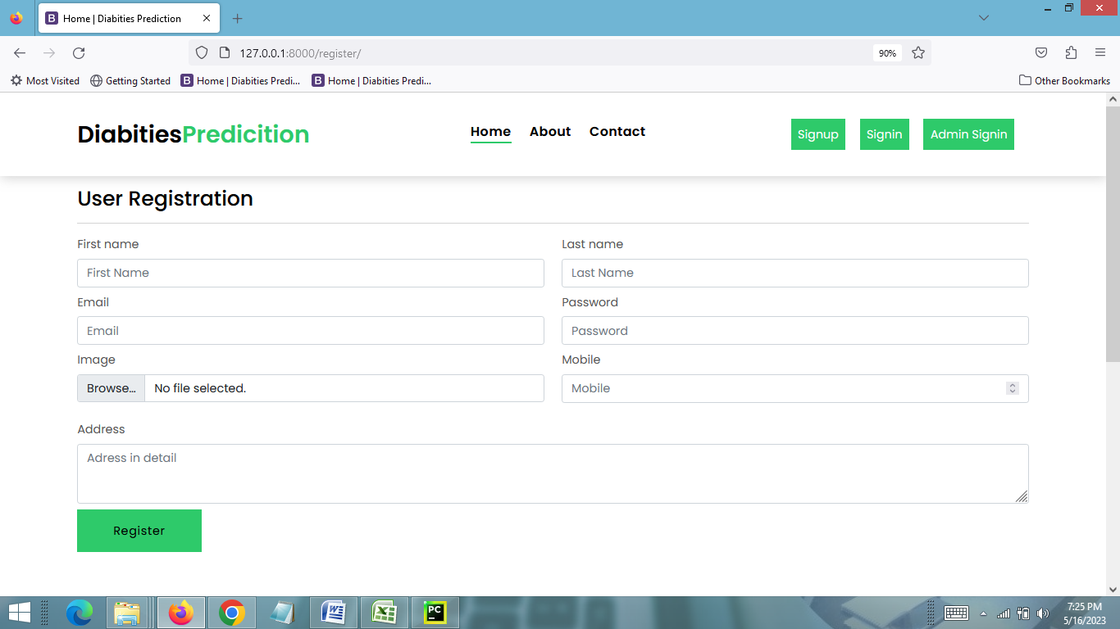
User Registration Page

Slide 28
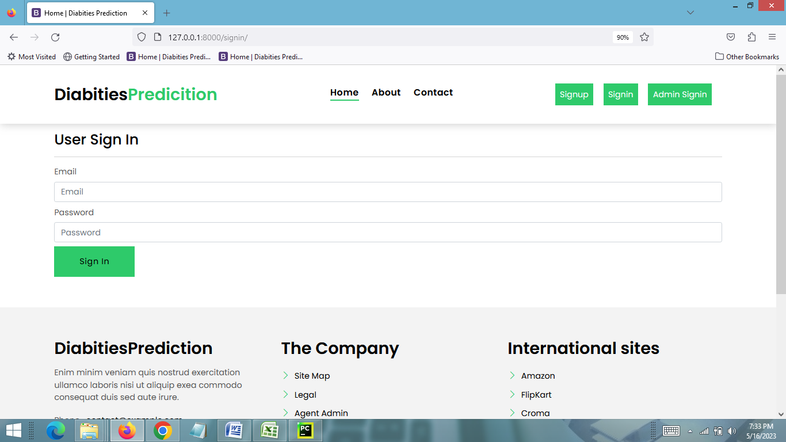
USER LOGIN PAGE

Slide 29
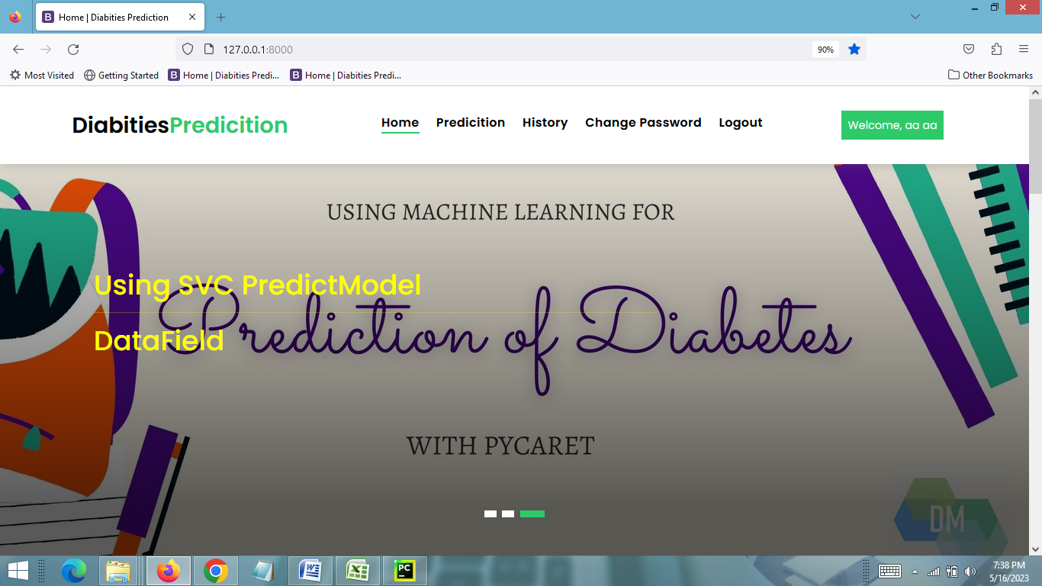
USER HOME PAGE

Slide 30
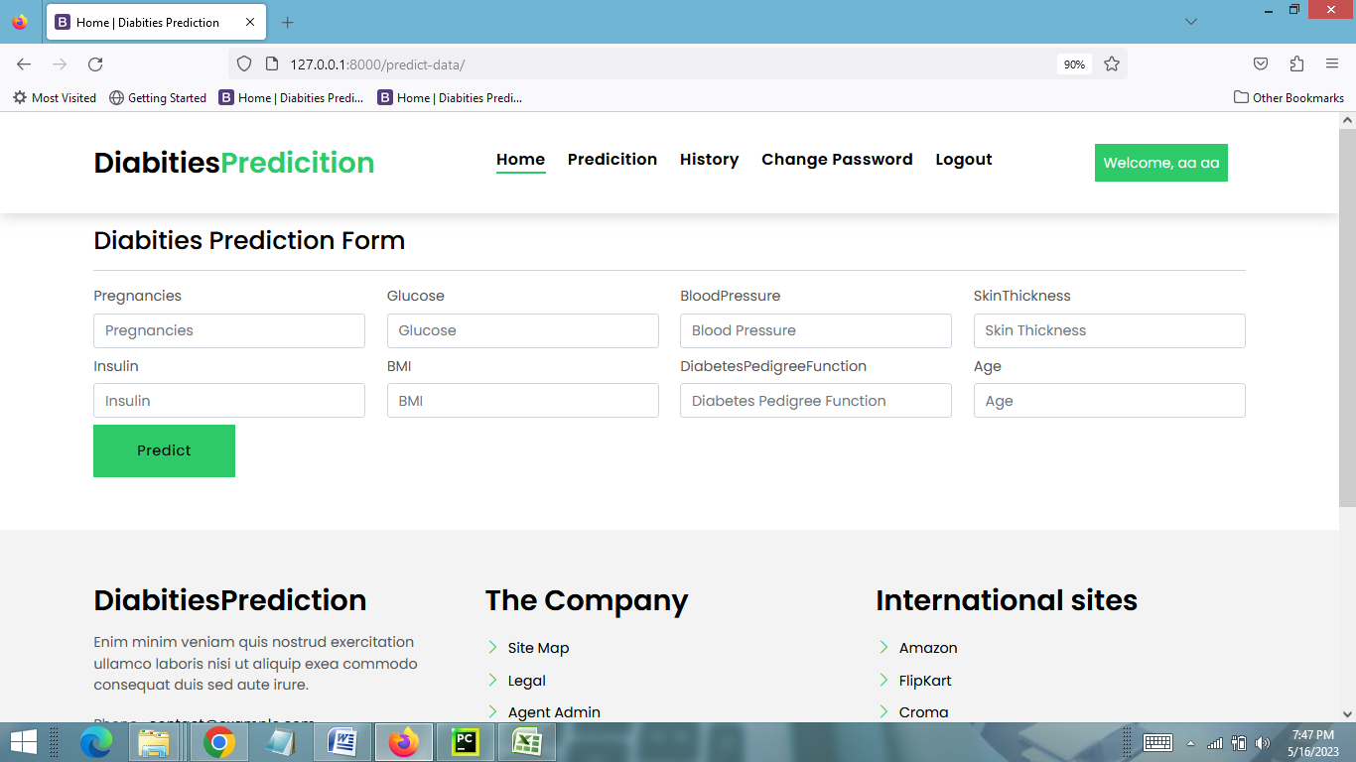
DIABETES PREDICTION PAGE

Slide 31
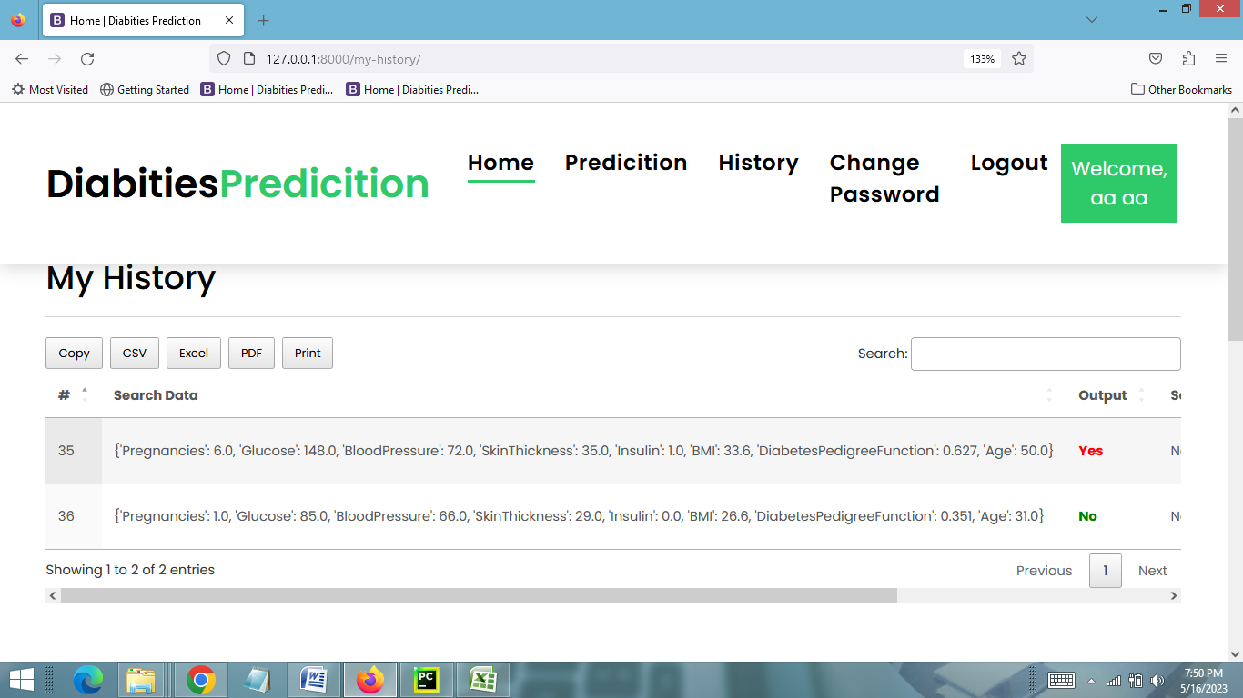
PREDICTION RESULTS PAGE

Slide 32
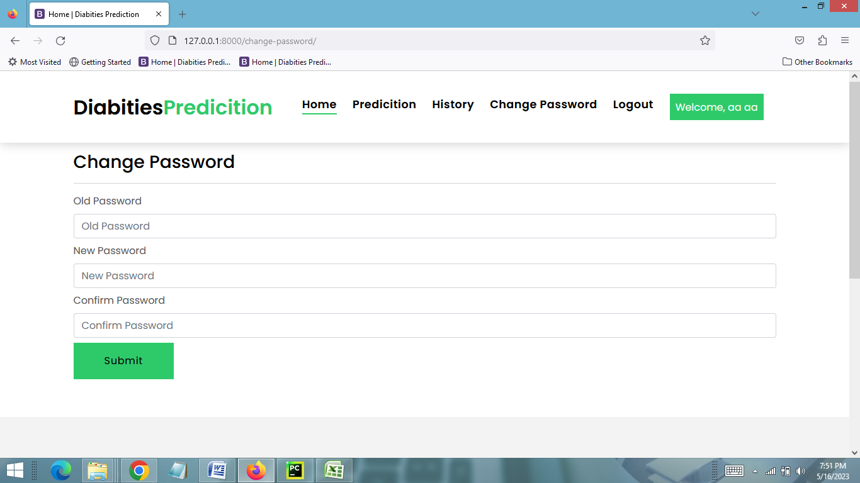
Change Password Page

Slide 33
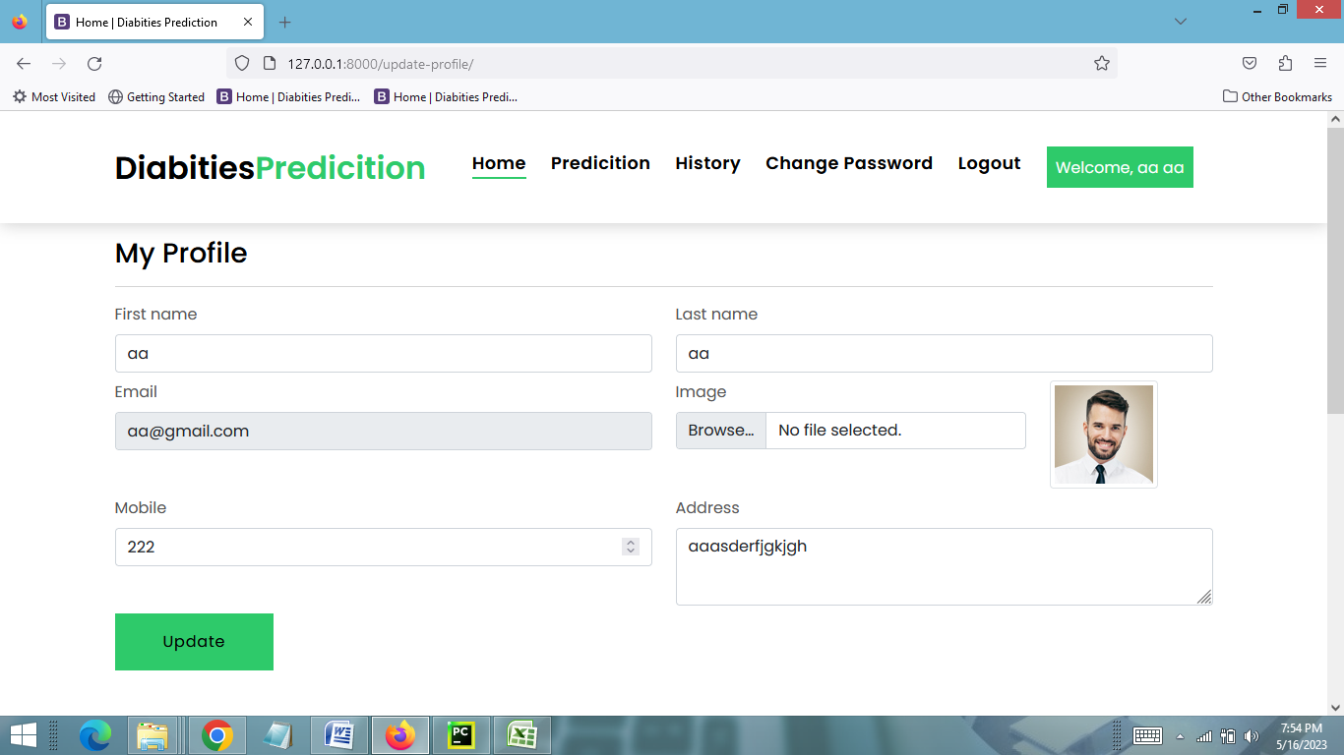
Edit Profile Page

Slide 34
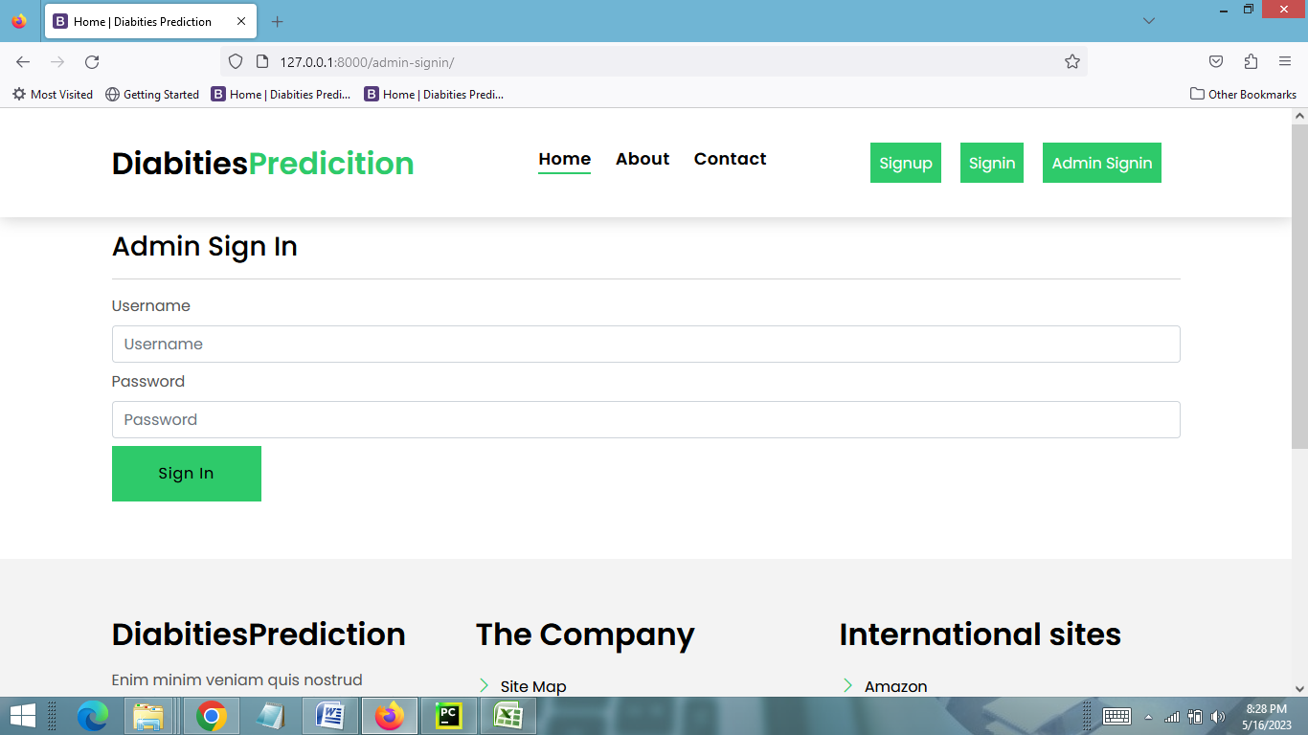
ADMIN LOGIN PAGE

Slide 35
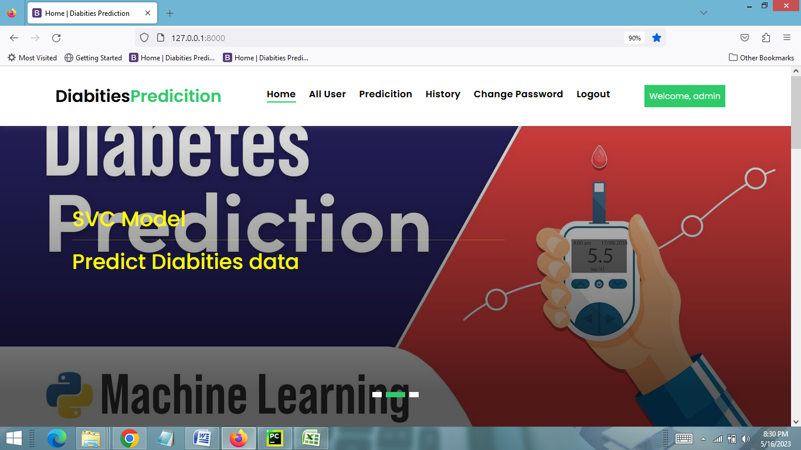
ADMIN HOME PAGE

Slide 36
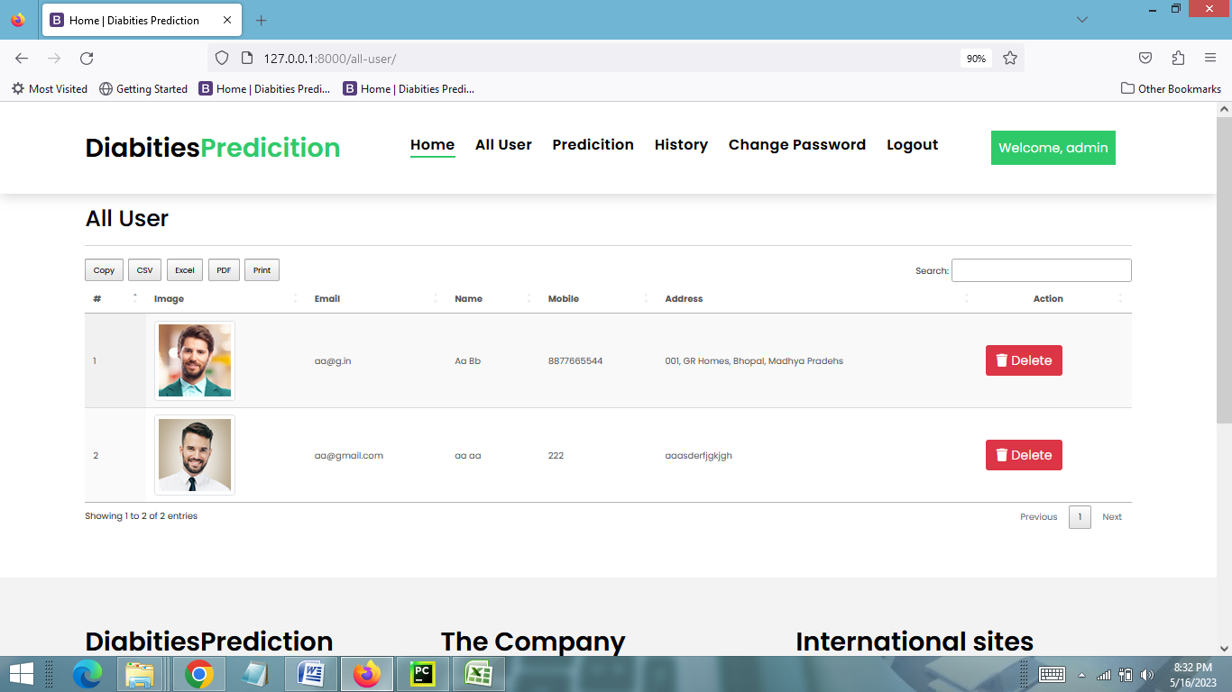
VIEW ALL USERS PAGE

Slide 37
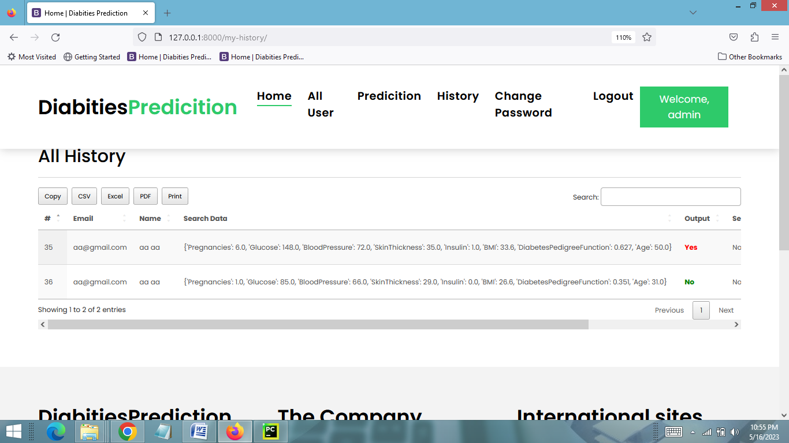
VIEW ALL PREDICTION HISTORY PAGE

Slide 38
FUTURE SCOPE
The future scope of the Diabetes Prediction System using Support Vector Machine can include the following:
Incorporation of additional features for improved prediction accuracy.
Ensemble methods to enhance the system's performance.
Integration with wearable devices and health tracking apps for real-time data collection.
Personalized risk assessment based on individual characteristics and lifestyle factors.
Long-term disease monitoring and personalized interventions.
Development of a mobile application for remote monitoring and personalized feedback.
Collaboration with healthcare professionals through electronic health record integration and telemedicine platforms.
Continuous model improvement to stay up-to-date with advancements.
Integration with public health initiatives for population-level insights and preventive measures.
Research and data sharing to advance diabetes prediction and management.

Slide 39
CONCLUSION
In conclusion, the Diabetes Prediction System using Support Vector Machine is a valuable tool in the field of healthcare. It leverages the power of machine learning and data analysis to predict the likelihood of diabetes in individuals. The system offers advantages such as high accuracy, efficient analysis of large datasets, and user-friendly interfaces for both users and administrators. However, it is important to acknowledge the limitations of the system, such as its dependence on accurate and comprehensive datasets and the need for continuous updates to stay relevant. It is crucial to prioritize privacy and security when handling patient data and to comply with relevant regulations and ethical considerations. The future scope of the system lies in incorporating advanced algorithms, integrating with other healthcare technologies, and personalizing risk assessments and interventions. By continuously improving and updating the system, we can work towards better diabetes management and prevention, ultimately improving the overall health and well-being of individuals.

Slide 40
BIBLIOGRAPHY
FOR PYTHON INSTALLATION
https://www.python.org
FOR HTML , CSS AND PYTHON BASICS
www.w3schools.com
www.javatpoint.com
https://www.geeksforgeeks.org/python-django/
https://panjwanitutorials.com/
REFERENCE BOOKS
Two scoops of Django for 1.11 by Daniel Greenfeld’s and Audrey Greenfield
Lightweight Django by Elman and Mark Lavin

Slide 41
THANKYOU

